Slide 1
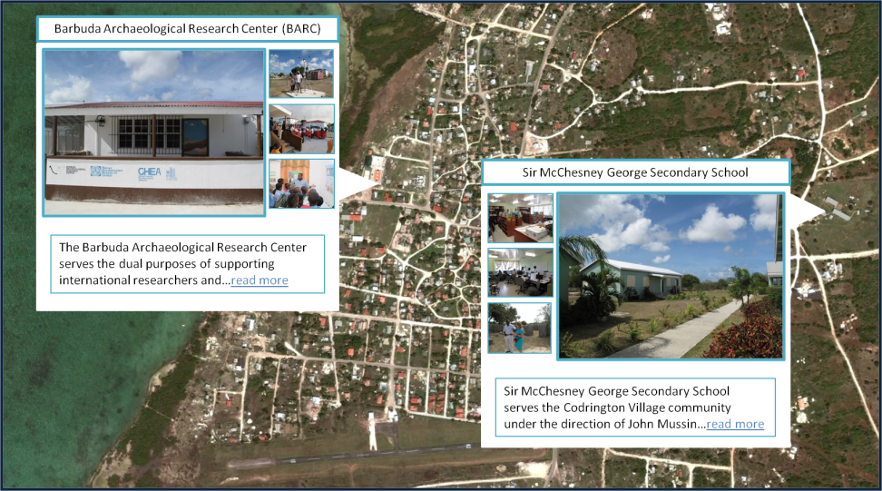
CUNY Human Ecodynamics Research Center (HERC)
The GPS+Camera Project: Youth Sustainability Research and Dialogue
Mussington, J.₁, McGovern, D.₂, Perdikaris, S.₃, Newton, A.₄
Sir McChesney George Secondary School, Codrington, Barbuda₁; Teachers College, Columbia University, New York, United States₂; Brooklyn College, New York, United States₃; University of Edinburgh, Edinburgh, United Kingdom₄
The GPS+Camera Project
The GPS+Camera project combines two complimentary features:
short sustainability modules in different high school subjects staggered throughout the year emphasizing on original interdisciplinary research, local context as the basis for curriculum, and human-environmental interactions
The GPS+Camera website shared by schools across the Atlantic that allows students to publish their research and engage in sustainability dialogue with students abroad.
June 2012 Pilot Project:
Historic Codrington
The GPS+Camera Website
Publishing original student research to an international audience
International youth sustainability dialogue
For updates and more information see: www.gheahome.org, www.nabohome.org, and http://herc.ws.gc.cuny.edu
Acknowledgements: CUNY Human Ecodynamics Research Center, NSF Grants 0851727, 0732327, 114106
Contact: daniel.f.mcgovern@gmail.com

